Slide 1
Challenges of Self-directed Learning

Slide 2

A teacher who needs to know about self-directed learning!
Notes:
The Teacher before using Livewire Learning as a self-directed learning resource. ☺

Slide 3

A teacher who knows about self-directed learning!
Notes:
Teacher after using Livewire Learning as a self-directed learning resource. ☺

Slide 4

Resourcing and Facilitating Self-directed Learning How to work SMARTER not HARDER

Slide 5
WORKSHOP OUTLINE
1. Hand out resource sheets
2. Introduce myself and briefly describe the current state of teaching at Westmount
3. Share briefly about the principles of SDL and how it works at Westmount School
4. Macro level changes to the teaching and learning programme
5. Micro level changes to my teaching and learning programme
6. Life in the Learning Centre
7. Equipping self-directed learners
8. Feedback to improve learning
9. Practical resources
a. Livewire Learning: elearning + workbook resources
b. MEPO: collaborative learning – an SMS designed by students for students.
Notes:
I have been involved in education all my life. I was HoD English at Southland Boys’, spent two years overseeing the Livewire Learning project and currently teach at Westmount School. Teaching is about selling success and I see Livewire as a practical and proven way to assist students become self-directed learners and enable teachers to facilitate this and focus on the key role they play.
My belief is based on my experience: In sport, I have been successful when I have acquired and applied the discipline to practise the necessary skills so that I could perform well in the game. Success then breeds success. This program is designed to give students the opportunity to practice key skills, apply that knowledge, extend themselves, develop critical thinking skill, become independent learners and taste of success.

Slide 6
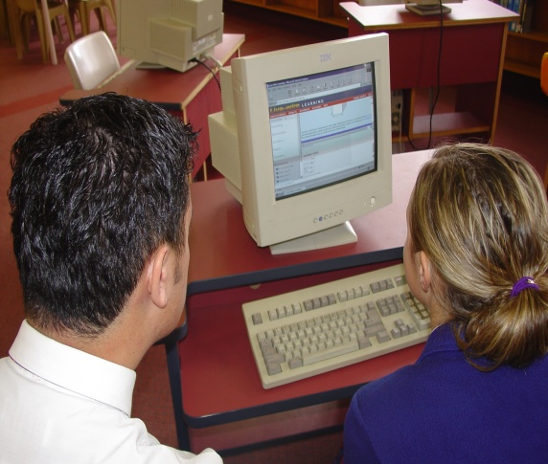
2. SDL @ Westmount School: Yrs 9-13
Leaning Centre
Teacher
Student
Mentor
Moodle
SDL – Blended Learning for all Yr 9-13
Yr 9 and 10 French
Year 11, 12, 13 English
Notes:
Self-directed learning at Westmount School. I teach in a Video Conference (VC) room and the Learning Centre (LC) where I conference with Yr 10-13 students who work independently or collaboratively. All my classes - Yr 9 and 10 French and Years 11, 12, 13 English - are by Video Conferencing and are only two 50 min periods a week; their other two periods are in the LC where they work independently on work set on Moodle.

Slide 7
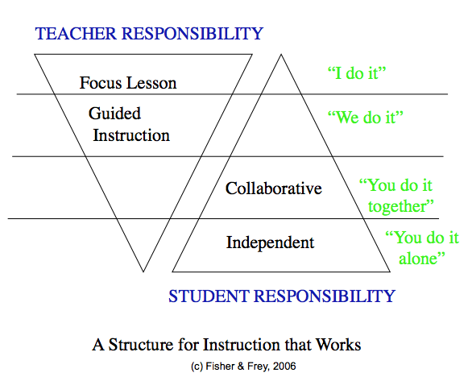
3. WHAT IS SELF DIRECTED LEARNING?

Slide 8
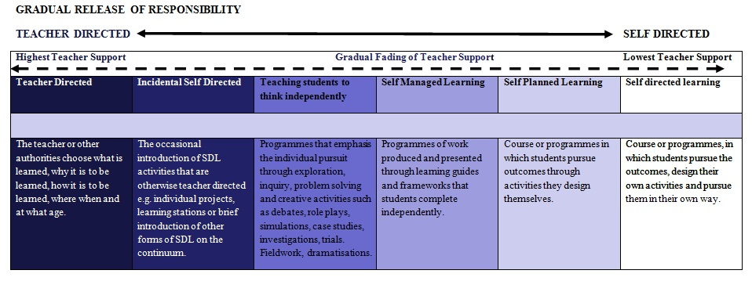
3. WHAT IS SELF DIRECTED LEARNING?
Notes:
Livewire Learning fits well in the Self Managed Learning column.

Slide 9
3. WHAT IS SELF DIRECTED LEARNING?
• The spectrum of self directed learning begins with teacher directed learning and the responsibility gradually shifts to the learner
• Self directed learning views learners as responsible owners and managers of their own learning process.
• SDL recognises the significant role of motivation in initiating and maintaining learner’s efforts
• Developing the skills and attitudes of self directed learning is not relative to age or Year level at school.
• Some students acquire these skills somewhat naturally and for others they need to have the skills modelled, demonstrated and taught as a deliberate act of teaching

Slide 10
3. WHAT IS SELF DIRECTED LEARNING?
• Each teacher is responsible for ensuring that students in their class have the necessary skills to work independently in a self-directed way.
• Teachers scaffold learning by making it “visible”. They model learning strategies and work WITH students so they develop the ability to use them on their own
• One of the most important role of the teacher is to raise student awareness of their roles in learning
• SDL is highly collaborative. Learners collaborate with teachers and peers.
• SDL recognises domain specific knowledge as well as the ability to transfer knowledge to new situations.
• Self-directed learning allows students to be more effective learners and social beings.

Slide 11
4. Changes at the Macro Level of Teaching
Move away from face to face classes to VC (Video Conferencing)
2x2 lessons: 2 VC + 2 LC
Extensive use of an LMS – Moodle
Set times in the Learning Centre for contact with students, small group input
Notes:
There have been significant changes over the last three years.

Slide 12
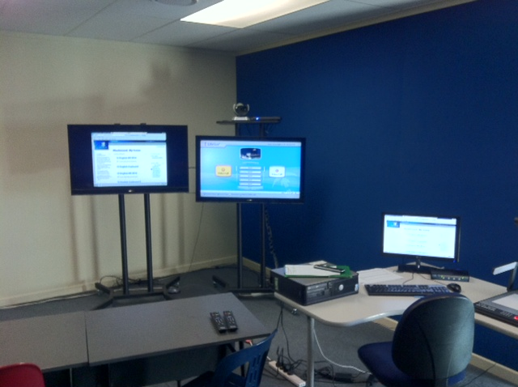
4. Changes at the Macro Level of Teaching
Notes:
My teaching space with its two large screens that enable me to see students on one and display material from the document camera on the other. I am able to access the internet, display power point slides and show DVDs from my seat.

Slide 13
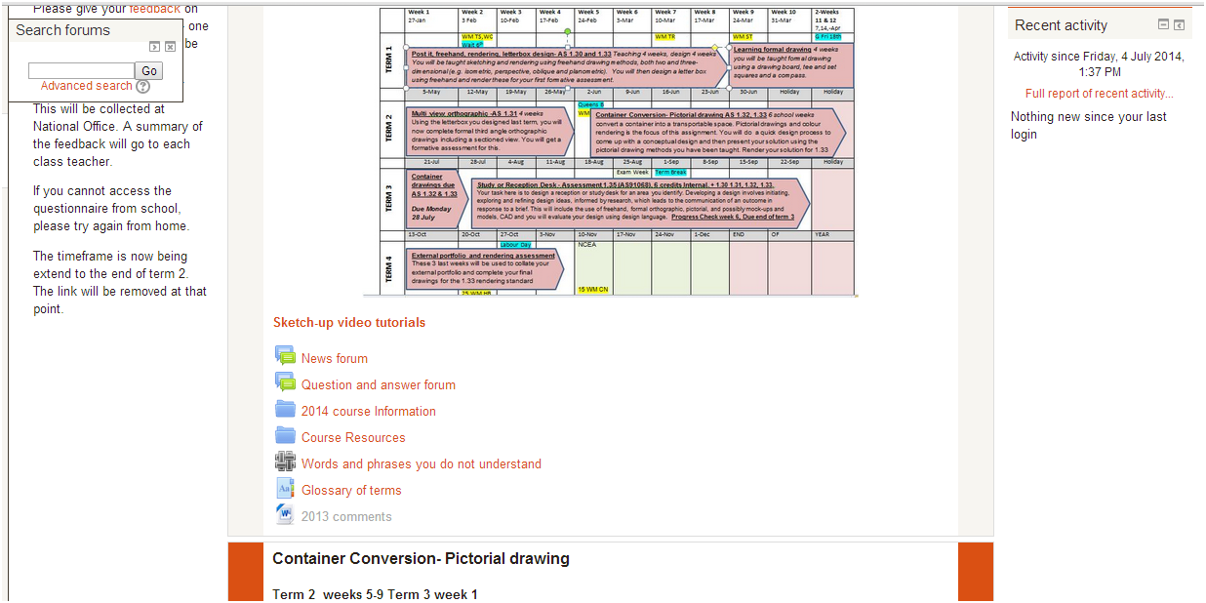
4. Changes at the Macro Level of Teaching
Notes:
This is a sample Moodle page where students can view their programme for the year.

Slide 14
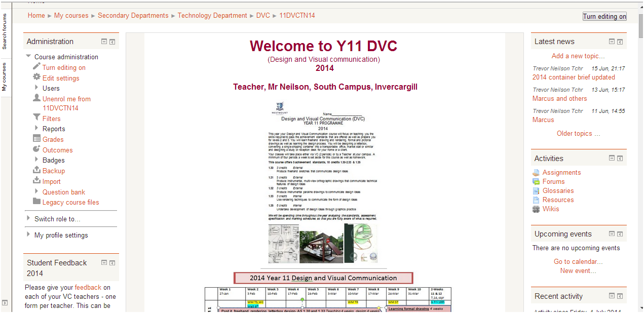
4. Changes at the Macro Level of Teaching
Notes:
This is a sample Moodle page where the teacher can communicate with students, outline work for the week, documents to read, print off and bring to class.

Slide 15
5. Changes at the Micro Level of Teaching
More detailed planning for the year, term and week
Work put up on Moodle each Sunday for both VC and Learning Centre periods. Students need to read it, download resources and bring them to class
Use of forums and wikis for discussions, collaborative projects, uploading of seminars
Assignment pages for formative and summative assessments

Slide 16
SDL English@ WESTMOUNT SCHOOL
King Lear – 2x2
Wiki for responding to the film
Wiki for sharing ideas for seminars
Forum Q&A for communicating with teacher and one another
Notes:
Ways I have facilitated SDL in my classes: 1. Year 13: In 2011 as part of transitioning to full VC classes my Yr 13 class had 2 periods of face to face teaching and 2 periods where students worked independently, accessed material from the LMS Moodle platform or had conferences with me. Our study of King Lear worked well – contact me for details. 2. Year 9-10 combined class: a. Yr 9 students work independently on their autobiographies while we study Roald Dahl’s Boy and explore aspects of style – tone, language, description – etc that they can weave into their own writing. b. Year 10 students, during their study of Boy in Stripped Pyjamas, work in groups taking responsibility for reading assigned chapter summaries and analyses written by students from previous years. They read, analyse, evaluate and improve on the summaries and then present them to the other groups. Copies of the improved version are made available on the shared area of the school’s file server so each student can save a copy. c. Short Story study: - We read and discussed two short stories in class - created a mind map of key features on the board - students then answered a Livewire module with teaching notes and questions on Key Features of the Short Story - we added notes to the class mind map - then students added these new points to their own copy. 3. Year 11 and 12: AS 1.3 and 2.3 Unfamiliar Text – this is an extension standard. Students work independently using Livewire Learning as follows: a. the student works through the modules in the Language Features, Poetic Devices, Sentence Structure folders
b. the student selects (or the teacher suggests) a close reading passage from the workbook.
c. the student, working at home or school, answers the interactive Livewire questions on the passage, getting instant feedback and explanations. (Livewire works particularly well on an iPad, or iPhone for that matter.)
d. the teacher can track the student's progress via the adminsuite; the student can record their scores in the work book.
e. the student then answers the NCEA style question in the workbook with real confidence and knowledge because the elearning questions have already scaffolded their understanding.
f. the student either conferences with the teacher about what has been written or reviews the answers against the suggested answer sheet which the teacher has.

Slide 17
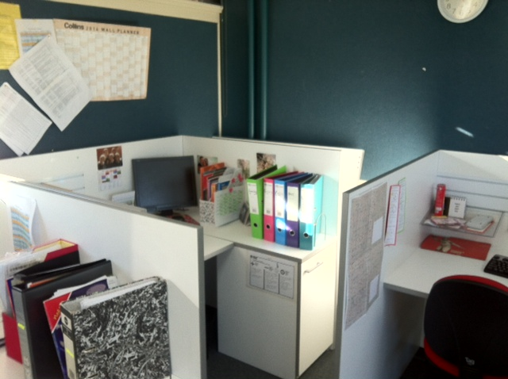
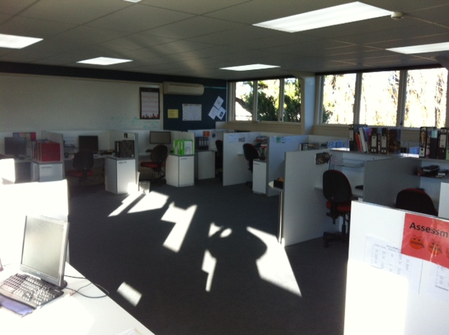
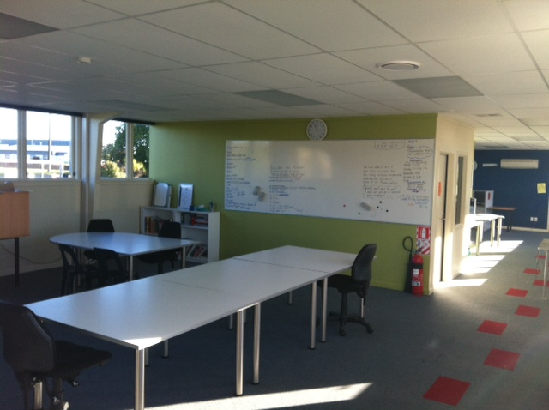
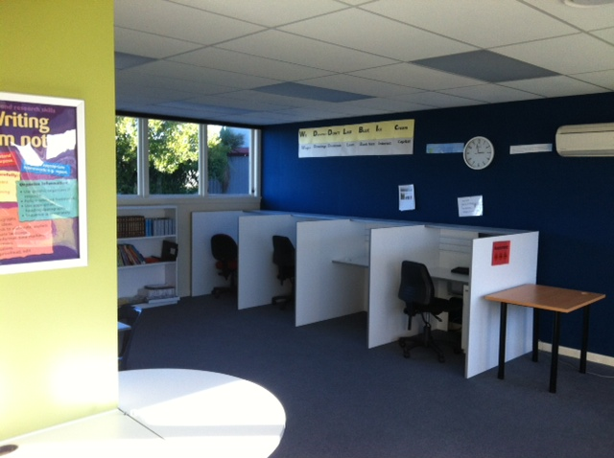
6. Life in the Learning Centre
Students have their own booths for quiet study
Time tables for each student’s learning programme
Discussion area for collaborative and peer tutoring
Appointments for one-on-one conferencing with LC supervisor

Slide 18
7. Equipping self-directed learners
Motivation: strong support from home; whole school approach.
LC Supervisor encourages students to ask: a. Have I read the required Moodle pages? b. Have I clarified the requirements with another students? c. Have I clarified the requirements with the LC? d. Now I contact the VC teacher.
3. Problems: a. Not keeping up? / Managing time? - Specific strategies eg Each week print off and paste on wall the weekly Moodle work. b. Motivation? - Talks with Mentor - Resilience c. Reflecting on successes and failures? - Conferences with LC supervisor – PMI Reflection sheet

Slide 19
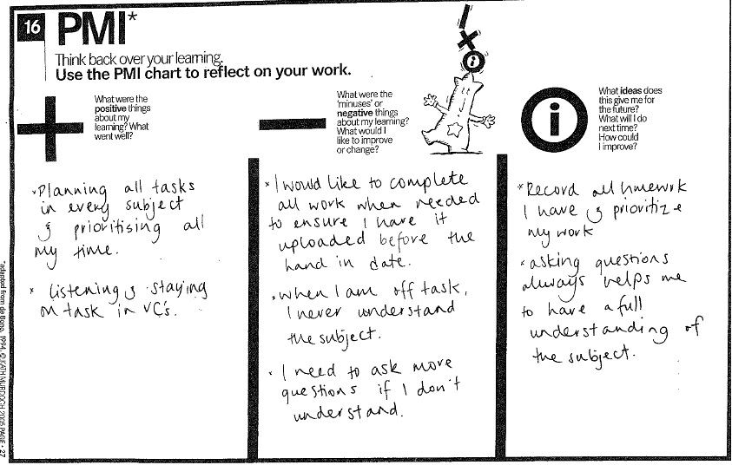
7. Equipping self-directed learners
Notes:
Copy of a student’s PMI with practical things that need to be done.

Slide 20
8. Feedback to improve learning
1. Make Learning Intentions and Success Criteria clear at the start and end of lessons 5 May - 11 May Welcome back to Term 2. I trust you had a refreshing break. LEARNING INTENTION By the end of the next two weeks, you will: - be able to plan and write a report connecting ideas in short stories you have read.
SUCCESS CRITERIA By the end of the next two weeks, you will: - be able to summarise your key connections with examples - be able to plan a report connecting at least 4 stories by an author - be able to write a report that makes at least two connections, shows your response to and evaluation of the links - provides supporting evidence from the texts
TERM OVERVIEW This is a shorter term with only 9 weeks. As per the term time-table we have Weeks 1 and 2: Connections Report Weeks 3 - 7: Film study of Amazing Grace. Weeks 8 and 9: speech writing (Assessed Term 3 week 1) Week 1 VC 1 and LC 1: Work on summarising Connections logs onto summary templates and plan the basic structure of your report. VC 2 and LC 2: a. Start hand writing the first draft of your Connections Report.
Notes:
As a results of attending the Making Learning Visible course run by Cognition during the second week of the April holidays, I have been focussing on making my Learning Intentions and Success Criteria more visible, and on providing more helpful and focussed feedback.

Slide 21
8. Feedback to improve learning
2. Enable our students to be assessment-capable learners so that they
a. know about their learning and can plan their next steps b. are active in their learning c. understand the learning intentions and success criteria
d. can peer assess against the success criteria
e. are able to track their progress against the rubric and exemplars
f. are able to answer the questions: - Where am I going? - How am I going? - Where to next?

Slide 22
Feedback to improve learning
3. Help students set SMARTER goals
Specific Measurable Achievable and ambitious Relevant Timely Evaluate Re-evaluate

Slide 23
Feedback to improve learning
4. “Effective feedback has the potential to double the speed of learning.” (Cognition) So give feedback that a. is JUST IN TIME and JUST FOR ME
b. gives students information about - Where I am going? - How I am going? - Where to next?
c. does more than praise but addresses the task, the process and self-regulation
Notes:
Helpful notes from the Cognition conference

Slide 24
Feedback to improve learning
c. Give feedback that addresses i. The Task Level: - What is the correct answer? - Is his/her answer correct? - What did he/she do well? - Does the answer meet the success criteria?
“Your learning goal was to structure your recount according to the steps you followed in your experiment . You begin well but then the order gets muddled. You need to go through what you have written and number the order in which things happened and then rewrite them in that order.”
Notes:
In week 1 of Term 3 the Year 11-13 students had an End of Topic essay on film. I was able to mark these and then visit my students in Timaru and Dunedin to conference with them about their essays and essay writing techniques. This was a very helpful time for all.

Slide 25
Feedback to improve learning
ii. The Process Level: - What is wrong and why? - What strategies did he/she use? - What is the explanation for the correct answer? - Does the answer meet the success criteria? - What are the relationships with other parts of the task? “You are asked to compare these ideas so you could try to see how they are similar, how they are different, and how do they relate together?”

Slide 26
Feedback to improve learning
iii. Self-regulation Level: - How can she/he monitor her/his own work? - How can he/she evaluate the information provided?
- How can he/she reflect on his/her own learning? - What learning goals has he/she achieved? “You checked your answer with the resource book/on Livewire (self-help) and found you got it wrong. Any ideas about why you got it wrong (error detection)? What strategy did you use? Can you think of another strategy to try? How else could you work it out if you are correct?”
iv. Self level Praise = encouraging but does not close the learning gap!

Slide 27
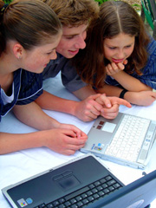
E-LEARNING + WRITE-ON = SUCCESS
9. PRACTICAL RESOURCES
The innovative learning approach
Notes:
Information on how Livewire Learning can assist with implementing self-directed learning.

Slide 28

What is Livewire Learning?
It is an affordable, interactive, adaptive web-based learning management system: discrete modules of work + Q and A + explanations + records of learning + tracking and reporting
It provides revision, study and homework material in secondary school Science, Physics, English, Mathematics, and Accounting.
It integrates elearning and work book resources.
Written by experienced NZ teachers and aligned to the NZ Curriculum
Based on Bloom’s taxonomy
Notes:
Note that if schools have purchased the Achievement@English booklet, they already have access to a licence code for each student that can be found in the inside front cover. It can be used at any time during the year or as part of the Revision section provided in the back of the book.

Slide 29
How does Livewire fit the Curriculum?
Livewire Learning
1. Was written by published authors and experienced teachers
2. Addresses the Key Competencies of: - CRITICAL THINKING - MANAGING SELF - USING LANGUAGE, SYMBOLS AND TEXT
3. Aligns closely to the NZ Curriculum. English Years 7-10 aligns with Levels 3-5 and will assist in preparation with eAstlle and PATs. Year 11 and 12 subjects target skills needed for most of the Achievement Standards

Slide 30
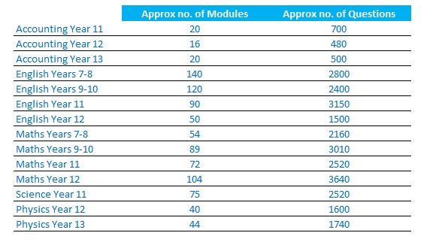
Scope of Livewire Subjects

Slide 31
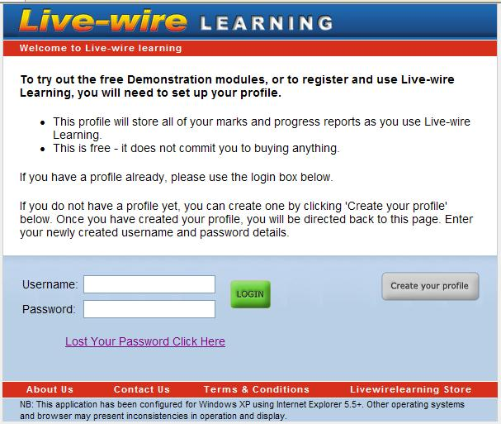
1. LOG IN to http://my.livewirelearning.co.nz
Notes:
Steps to log in

Slide 32
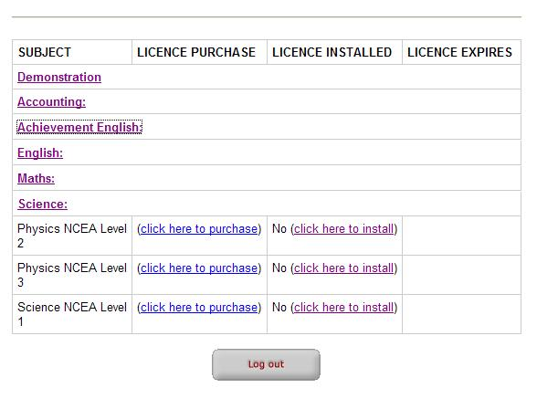
Install your Licence Code
Notes:
Click on the hyper linked subject then click on the hyperlinked words: click here to install to open up

Slide 33
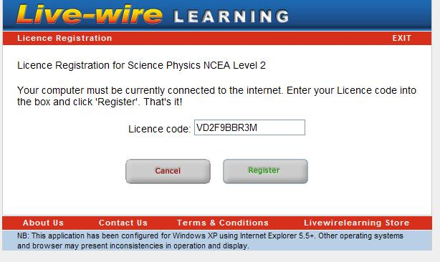
Activate your Licence
Notes:
Copy and paste the subject specific code in the box.

Slide 34
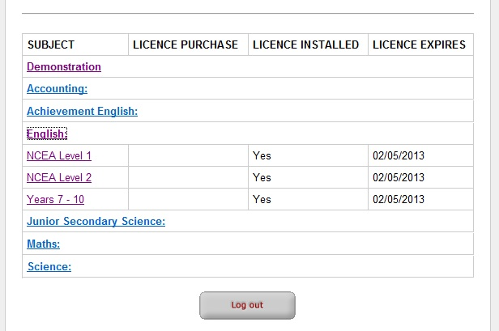
Subjects Activated
Notes:
These subjects are now active until they expire on the date given.
Click on the hyperlinked subject title. a. Click on the general subject, e.g. English and then the actual subject you are now licensed to use
b. Read the instructions or on the left hand grey panel, then drill down on the ‘subject name’ - 'Click Here' link until you see the folders. (Each of these contains the module titles.)
c. Click on any of the module titles then
d. Read the teaching notes, answer 10 questions and view your summary score. Check your progress 'speedo' under the RESULTS link.

Slide 35
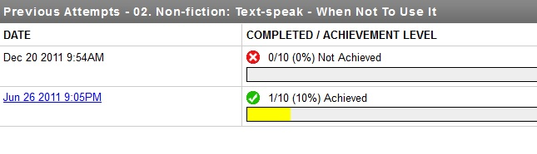
Previous Attempts
Notes:
This shows the student how many questions they have answered correctly. When the green bar reaches the end (see 06 Fiction: Autumn at Luggate Pub), all the questions in the module have been answered correctly and maximum points have been achieved.

Slide 36
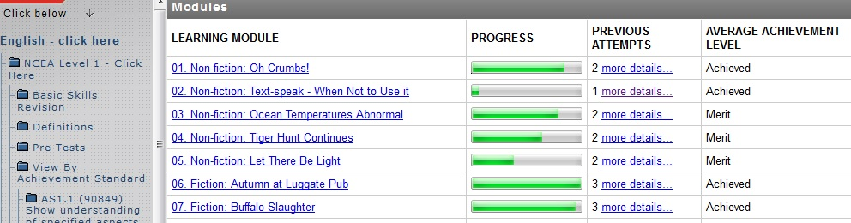
Modules
Notes:
This shows the student how many questions they have answered correctly. When the green bar reaches the end (see 06 Fiction: Autumn at Luggate Pub), all the questions in the module have been answered correctly and maximum points have been achieved.

Slide 37
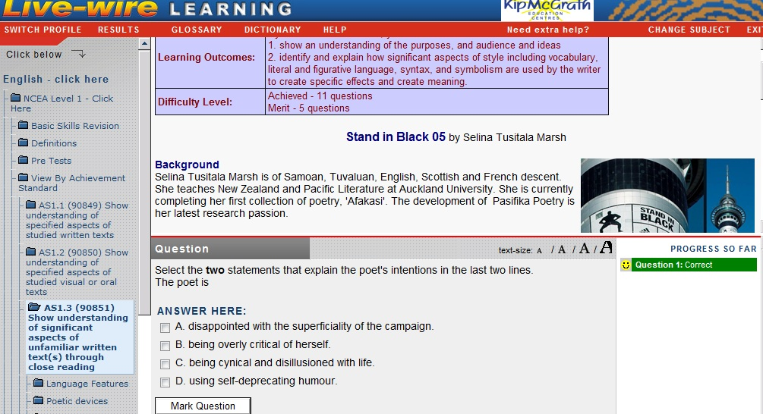
Module
Notes:
This question is a Merit level question requiring students to think more broadly.
Each red or green question can be clicked on to access the correct answer and explanation.

Slide 38
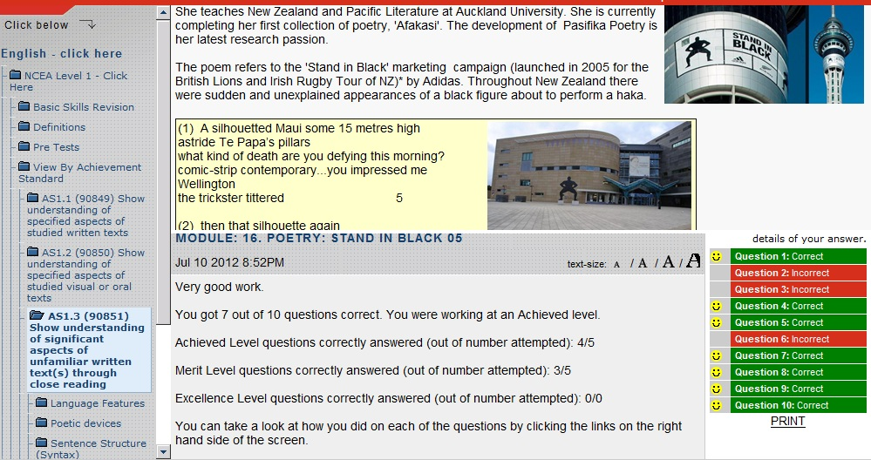
Final results print out
Notes:
Sample FINAL RESULTS. Each red or green question can be clicked on to access the question, answer and explanation. This is helpful if a teacher wishes to discuss a student’s answer.

Slide 39
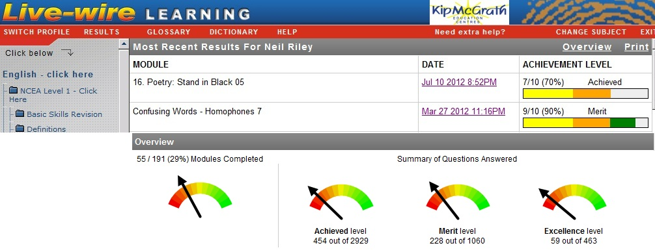
Most Recent Results for …
Notes:
Most Recent Results: 1. Shows completed modules 2. Each date can be clicked on to drill back into the test and access the question, answer and explanation. 3. Placing the cursor over the yellow, gold or green bar indicates how many questions were answered correctly at each level. 4. The Overview indicates how many modules and questions have been answered and how many more are left to do.

Slide 40
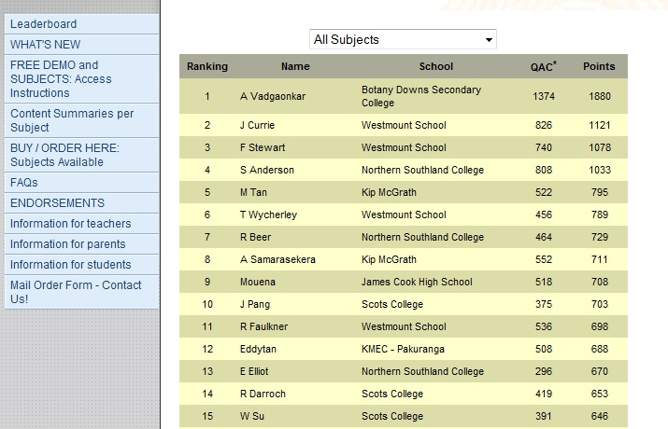
Leader board
Notes:
The leader board shows how many questions have been answered correctly and the points earned for the year so far.

Slide 41
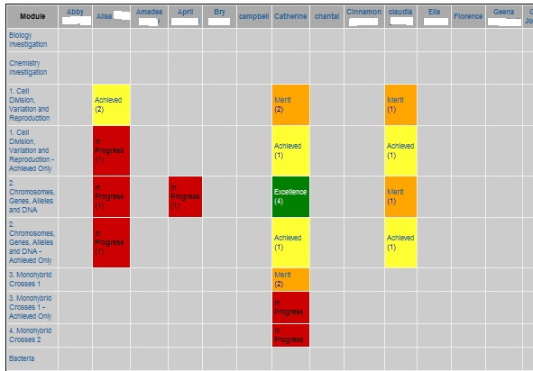
The Administration Suite
Notes:
Contact me for further details but in summary the adminsuite allows a teacher to
assign students to the school
create classes
assign students to a class
view results for individual student or a whole class or per module – see slide above
track progress
click on a module title – see above – to see which students have completed the module, how many times, how successfully.
print individual reports of work completed over specific time periods.

Slide 42
Additional Notes
1. Ways to use Livewire Learning at school a. Set as homework Set work linked to current Achievement Std/topic of work; students print off results and paste into folders as evidence of completion; get parental sign-off each fortnight; use the admin suite to check at the end of each week. Link with the write-on work book
b. Use in class i. Use the teaching material on the data projector / whiteboard
ii. Introduce the topic using Livewire teaching point or Link with the write-on work book iii. Pre-test using Livewire questions as a class iv. Work in groups or have in-class competitions

Slide 43
Ways to use Livewire Learning at school
c. Use in the computer suite
i. To introduce students to the programme and familiar with it ii. Work through folder as revision iii. students work in pairs for cooperative learning
d. Differentiated Learning Assign different students/groups different folders and modules. The more able may do normal modules with A, M and E level questions. Less able will start with AO versions.
e. Encourage goal setting and facilitate self-directed learning. Students repeat modules and aim to improve results.

Slide 44


2. Bloom’s Taxonomy
Questions are linked to Blooms taxonomy. a. In the skills modules, Achieved, Merit and Excellence questions are just harder/more challenging questions. b. In the Achievement Standard modules, the levels contain questions that require students to: Achieved = Recall, show Understanding and Apply Merit = Explain/Analyse Excellence = Discuss/Evaluate

Slide 45
3. Adaptive learning: a. Each module has an item bank of between 10-40 questions. The Learning Outcomes table at the start of each module indicates the number of questions at each difficulty level. b. As students get answers correct, they get given more challenging questions. c. Students should repeat modules to access additional questions in the item bank.
4. Leader boards: Achieved level questions earn 1 point Merit level questions earn 3 points Excellence level questions earn 5 points Students can compare themselves against other students on the home page leader board. Or see where they score in relation to other students in their school via the leader board within their login.

Slide 46
5. Principles of Accelerated Learning
1. Immediacy of feedback - Livewire marks instantly whereas teachers often take work home to mark and bring it back to students the next day. - There is a 5 minute learning cycle vs. a 24 hour one. Livewire therefore has the ability to have multiple learning cycles in one period.

Slide 47
Principles of Accelerated Learning
2. Individualised and specific feedback. Even if you have 20 students in a computer suite the feedback is specific to the student and to the content. This can never be achieved by a classroom teacher unless immediacy is sacrificed.

Slide 48
Principles of Accelerated Learning
3. Immediate reinforcement of appropriate cognitive strategy. The green (correct) answers immediately reinforce correct thinking strategies.

Slide 49
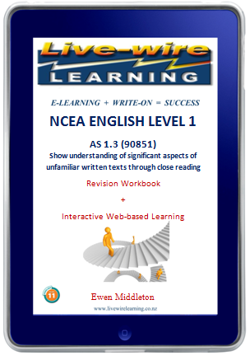

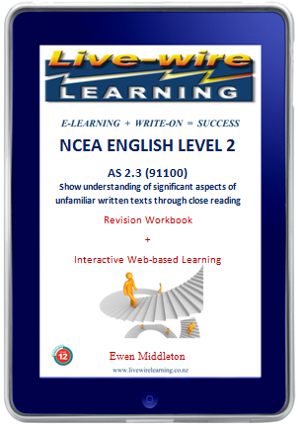
Workbooks – facilitating SDL
Notes:
Work books that provide a comprehensive course in English skills for Years 9-12.

Slide 50
Workbooks – facilitating SDL
By using both the elearning material and the work book students can now
Use the detailed teaching notes as revision material.
Go on line and use the eLivewire programme to answer the Achieved-Only version first to test their knowledge and understanding
3. Get instant feedback from the online questions and explanations to accelerate their learning.
Return to the workbook to challenge themselves with scaffolded higher order questions
Return to eLivewire to answer additional Merit and excellence level question and get instant feedback.

Slide 51
Workbooks – facilitating SDL
By using both the elearning material and the work book you can now
6. Re-sit the module to improve your score out of 10 and 'working at' level.
7. Track your record of learning and your place on the leader board (see our home page).
8. Answer an NCEA-style questions in the booklet. Either self-mark or ask your teacher to mark them for you.
9. Use the definitions modules to rehearse key terms.
10 Access the write-on answers from your teacher
Notes:
Work books that provide NCEA style questions for these Achievement Standards.

Slide 52
Holly Higgins: Lecturer, School of Secondary-Tertiary Studies, Manukau Institute of Technology
“If you are prepared to put up to 20 minutes into setting this program up with your students, the time you will save in the long run is immense. The NCEA students can do self-directed work towards both their internals and their externals, and I have found that there are activities in there which would take me weeks to create. The students are best served by their ability to access every resource they may need to help them to progress, and as every teacher knows, we can only do so much!
This program helps both the eager students to excel and also the reluctant students to see results and feel good about their learning.”

Slide 53
Student Responses
Student – Year 11 English, Science, Accounting “In regards to the Livewire Learning system, it was very helpful in view of the build up to my exams ...
Livewire covers all the main subjects including the basics to the more advanced levels of thinking.
I feel I have benefitted from Livewire as it showed me where I was getting questions wrong and areas that I needed to cover more in-depth.
I found the online competition a great way to increase my enthusiasm for studying.

Slide 54
Student Responses
MEPO – Managed Educational Platform Online - enabling student-centred, collaborative learning
- an LMS designed by students for students
- BETA launch August - class or school trials available - Login: http://b.mepo.co/login

Slide 55
In Conclusion

Slide 56
Benefits for students
We believe the following elements are critical for your students’ success. Livewire Learning helps students become self-directed/independent learners because it:
Provides useful in-class support material
Provides structured homework during term
Provides comprehensive end-of-year revision material
Uses accelerated learning principles to improve learning

Slide 57

Why do students like using Livewire?
It’s appealing: it engages and motivates students
It provides variety and allows them to work productively on the computer
It lets them work at their own pace
They can see themselves improving
It accelerates their learning
Notes:
It appeals to Gen Y. This generation uses and is familiar with communications, media, and digital technologies – therefore this product suits their kind of learning environment
Livewire is basically text and images; it can be used on iPads and does not require high broadband speeds.
The focus is on content rather than simulations and animations.
Very helpful for parents because it empowers them to be able to work with their sons and daughters.

Slide 58
Livewire’s Benefits for Teachers
The programme was designed to
Save you time
Provide a way for your students to become more self-directed in their learning
Help you meet the needs of the different learning styles of students
Help you differentiate your learning programmes to meet the individual needs of students
Strengthen your students' chances of success, if used effectively
Provide a way of integrating IT into the teaching and learning programmes of school
Strengthen the link between school and home with regard to homework.

Slide 59
Contact details
Neil Riley editor@livewirelearning.co.nz 021 158 4288

